Slide 1
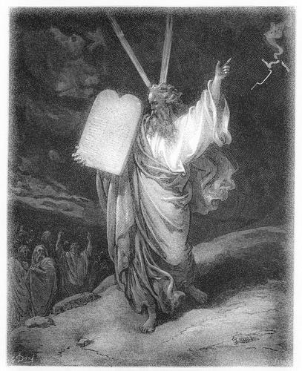
Joshua 1:1, 2
MY SERVANT IS DEAD

Slide 2
Death & Funerals
“…Till you return to the ground, For out of it you were taken; For dust you are, And to dust you shall return” (Gen. 3:19)
THROUGHOUT THE BIBLE
“and he died” (Gen. 5:5ff)
“…where Aaron died, and where he was buried…” (Deut. 10:6)
Abner (2 Sam. 3:31-39)
“Then Elisha died, and they buried him. …” (2 Kin. 13:20)
A widow’s son at Nain (Lk. 7:11-17)
Etc.
“You hide Your face, they are troubled; You take away their breath, they die and return to their dust” (Ps. 104:29)

Slide 3
Born in dangerous times (Ex. 1:22-2:4)
Rescued and adopted by Pharaoh's daughter (Ex. 2:5-10; Acts 7:19-22)
Made tough choices when he became of age (Heb. 11:24-27)
Sought to deliver his brethren (Acts 7:23-29)
Commissioned to deliver Israel out of Egypt at 80 years old (Acts 7:30-36)

Slide 4
God OWNED Moses
“Moses the man of God” (Deut. 33:1)
Does God recognize and own you?
1 Corinthians 6:19, 20
Romans 14:8
Deuteronomy 32:5, 6
Matthew 7:21-23

Slide 5
“Thus Israel saw the great work which the LORD had done in Egypt; so the people feared the LORD, and believed the LORD and His servant Moses” (Ex. 14:31)
“And Moses indeed was faithful in all His house as a servant…” (Heb. 3:5)
Are you a slave of God (Rom. 6:16-22)?

Slide 6
PHYSICAL DEATH is not a statement of SPIRITUAL CONDEMNATION
“I go the way of all the earth; be strong, therefore, and prove yourself a man” (1 Kin. 2:2; cf. Heb. 9:27)
“What man can live and not see death? Can he deliver his life from the power of the grave? Selah” (Ps. 89:48)
Ecclesiastes 9:1-9
Revelation 6:9-11

Slide 7
Desire to die as the righteous
Numbers 23:10
A refuge is found for the righteous
Proverbs 14:32
Fearless to face with the Shepherd
Psalm 23:4; Philippians 1:21
Precious in God’s sight
Psalm 116:15
Is blessed rest for those in Christ
Revelation 14:13

Slide 8
"But I know you, that you do not have the love of God in you” (Jn. 5:42)
“__________ My servant is dead”

